Slide 1

Microsoft Azure
Azure Portal Overview and General Best Practices
Katie Novotny #GlobalAzure

Slide 2
We’re Here to Talk About
Cloud computing
Microsoft Azure basics
How to use the Azure portal
Managing resources
Portal
CLI
PowerShell
Best practices
Resources to facilitate learning

Slide 3







Katie Novotny
A little about me
Dev(Sec)Ops | Automation | Cloudie| Application Development |
Not-so-Big Data | Power BI
DDI: ddiworld.com/
Meetups: meetup.com/Pittsburgh-Azure-Meetup/
Email: Katie.Novotny@gmail.com
Twitter: @KatrinaNovotny
LinkedIn: /in/katie-novotny

Slide 4
Flow of Conversation
Overview of Cloud Computing and Azure
Azure Portal Demos
Best Practices / Tips
Q&A
Feel free to put your hand up and ask questions along the way!

Slide 5

Tell me about cloud computing

Slide 6
Cloud Computing
Delivery of hosted services over the internet
As opposed to using a local machine
Resources are often virtualized
Pay on a usage basis
Email, store pictures, watch videos
Common terms:
Deployment Models
Types of Cloud Services

Slide 7
Deployment Models
Public Cloud
Private Cloud
Hybrid Cloud
Offered over public network and available to anyone for purchase
Microsoft Azure, AWS
Infrastructure and resources operated solely for a single organization
Private network
Can be hosted by third party (Rackspace, Sunguard) or on-prem
Combination of public and private clouds bound together
DB servers on-prem, web app in cloud

Slide 8
Types of Cloud Services: Cloud Computing Stack
IaaS
PaaS
SaaS
Base Layer
User will purchase, install, configure, and manage, including update, your own software/OS
Examples:
VM/VM Scale Sets, Containers, Hard Drive (Storage), Network, Load Balancers
VM with SQL Server installed
Usage:
Data Analysis, research, high computing needs, IT
IaaS plus operating system, programming language execution environment, database, web server, etc.
User manages data and applications, provider manages everything else
Examples:
Azure SQL Server, HDInsight, App Services, Functions
Usage:
Develop apps, developers
Cloud based applications offered over the internet
Examples:
Google Apps, Office 365
Usage:
Consumers

Slide 9

This is great stuff! Now, what can you tell me about Azure?

Slide 10
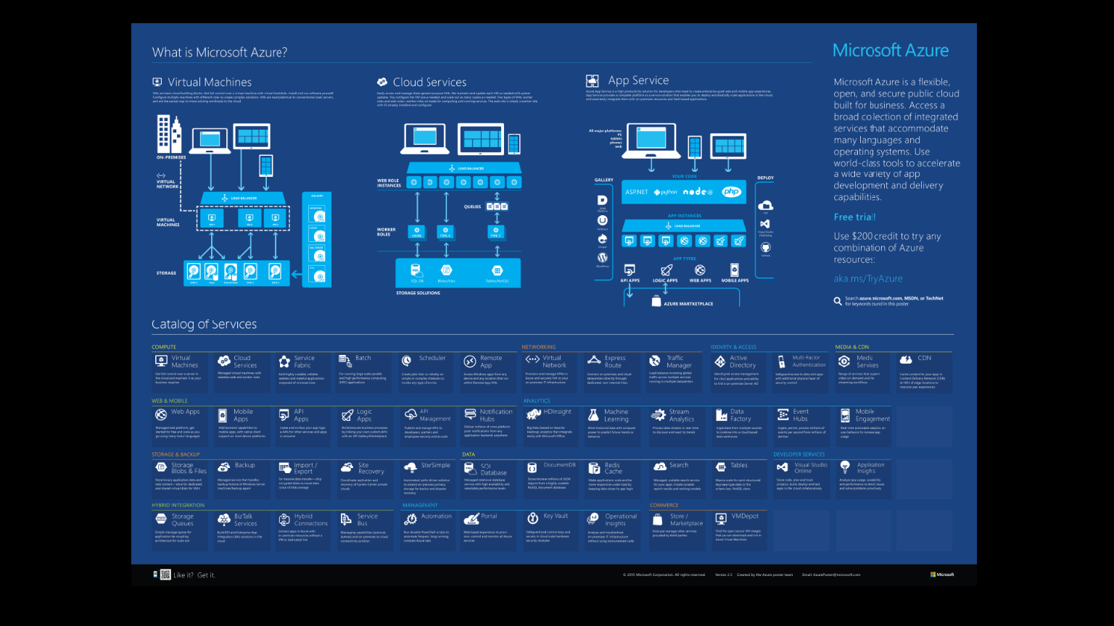
*Graphic from: https://azure.microsoft.com/en-us/resources/infographics/azure/

Slide 11
Azure Basics
Compute
Platform to execute applications
VM, App Service, Functions
Data Management/Storage
Azure SQL Server, DocumentDB, SMB, Blob, Table
Networking
Virtual Networks, ExpressRoute, Traffic Manager, CDN

Slide 12

SHOW ME THE MONEY!

Slide 13
Best Practices/ Tips and Tricks
Names are very important
Environment-ProductName-Purpose-AzureEntity-DataCenter
Prod-CRM-UI-Web-EastUS2
prodcrmstreastus2
Might need a numbering system based on scenario
App service plan
Represents a set of features and capacity that you can share across multiple apps
Shared Infrastructure per environment
Prod-SharedInfrastructure-RG-EastUS2
Must be S1 Instances to use CNAMEs

Slide 14
Best Practices/ Tips and Tricks cont.
SQL Server Firewall rule: Dynamic IPs will get you
Working from home
SQL Server itself, watch any internal monitoring
SQL Server users
No parity between Azure and on prem – watch role creation
Georeplicated secondary – back create user on Master from target DB
App Services
Use Connection String to hid secrets
Key Vault

Slide 15
Best Practices/ Tips and Tricks cont.
Tags on all resources
Billing
Schedule deletes of old resources
Locks on Resource Groups
Prevent accidental deletion
Set up Service Principal for automation
Allows non-interactive login
Service Account
No CNAMEs on Storage accounts

Slide 16
Resources
Azure Overview: https://docs.microsoft.com/en-us/azure/fundamentals-introduction-to-azure
Architecture and best practice for setting up and configuring cloud architectures: https://docs.microsoft.com/en-us/azure/architecture/
Azure Resource Explorer: https://resources.azure.com/
Videos: Friday.azure.com
AzCopy command line utility: https://docs.microsoft.com/en-us/azure/storage/storage-use-azcopy
Azure Data Movement Library: https://docs.microsoft.com/en-us/azure/storage/storage-use-data-movement-library

Slide 17
Resources
Tags: https://docs.microsoft.com/en-us/azure/azure-resource-manager/resource-group-using-tags
Azure Datacenter IP Ranges: https://www.microsoft.com/en-us/download/details.aspx?id=41653
Resource Manager/ARM Template:
https://docs.microsoft.com/en-us/azure/azure-resource-manager/resource-group-overview
https://docs.microsoft.com/en-us/azure/azure-resource-manager/resource-group-template-deploy
https://docs.microsoft.com/en-us/azure/azure-resource-manager/vs-azure-tools-resource-groups-deployment-projects-create-deploy
Create Usage and Billing Power BI Report: https://github.com/Microsoft/AzureUsageAndBillingPortal

Slide 18
Katie Novotny
A little about me
Dev(Sec)Ops | Automation | Cloudie| Application Development |
Not-so-Big Data | Power BI
DDI: ddiworld.com/
Meetups: meetup.com/Pittsburgh-Azure-Meetup/
Email: Katie.Novotny@gmail.com
Twitter: @KatrinaNovotny
LinkedIn: /in/katie-novotny

